Slide 1

Ecommerce Sentiment Analysis
Submitted By:
ANITA KATARIA

Slide 2
Introduction
The "Ecommerce Sentiment Analysis" project focuses on analyzing customer sentiment towards products available on Amazon. By using natural language processing (NLP) techniques, the project aims to extract and analyze customer reviews to understand the overall sentiment associated with different products and categories.

Slide 3
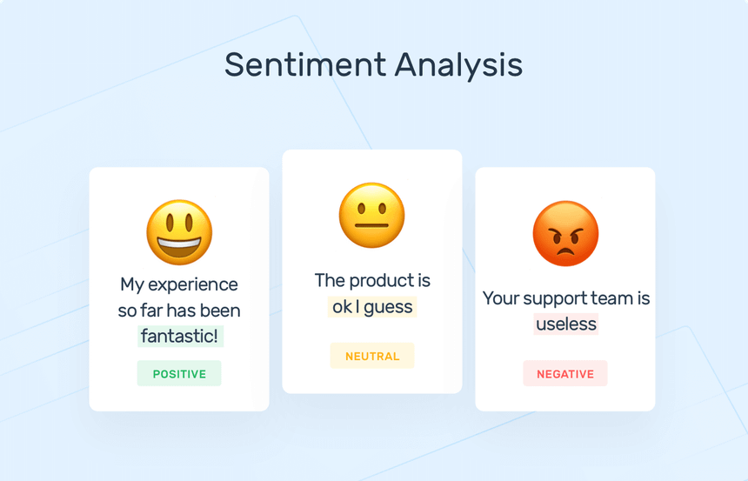

Slide 4
Problem Statement
Amazon is an online shopping website that now caters to millions of people everywhere. Over 34,000 consumer reviews for Amazon brand products like Kindle, Fire TV Stick and more are provided.
The dataset has attributes like brand, categories, primary categories, reviews title, reviews text , and the sentiment. Sentiment is a categorical variable with three levels "Positive", "Negative“, and "Neutral". For a given unseen data, the sentiment needs to be predicted.
You are required to predict Sentiment or Satisfaction of a purchase based on multiple features and review text.

Slide 5
Objectives of the Project
● Understand the sentiment expressed in consumer reviews.
● Address class imbalance in sentiment categories.
● Implement classifiers and advanced techniques for sentiment analysis.
● Evaluate model performance using appropriate metrics.
● Compare traditional machine learning algorithms with neural network approaches.
● Explore topic modeling techniques for clustering similar reviews.

Slide 6
Data Input
System Architecture
Pre-Processing
(Clean missing values,
Selecting important features.)
Deep Learning(NLP)
Sentiment Analysis
using NLTK
Run Model
Visualization..

Slide 7
Sentiment Analysis model:-
1) Text Review
2) Data Preprocessing
3) Sentiment Analysis
4) Sentiment Classification
5) Result

Slide 8
Machine Learning Algorithms
NLP(Natural Language Processing) –
Text Processing :-
Tokenization (splitting text into words or sentences)
Stemming (reducing words to their base form)
Lemmatization (reducing words to their dictionary form)
2. Sentiment Analysis :-
Emotional tone expressed in text
Review is positive or negative.
3. Text Summarization :-
Summaries of long texts, making it easier for users to grasp the main points

Slide 9
2) Sentiment Analyzer –
NLTK (Natural Language Toolkit) is a widely-used Python library for natural language processing tasks.
It provides various tools and resources that can be leveraged to create a simple sentiment analyzer.
Tools and Technologies–
Programming Languages: Python
Other Tools : Jupyter Notebook for development and experimentation.
Text Processing: NLTK (Natural Language Toolkit) for text preprocessing
TfidfVectorizer from Scikit-learn for converting text to Tf-Idf scores
Visualization: Matplotlib and Seaborn for data visualization.

Slide 10
Data Visualization & Representation

Slide 11
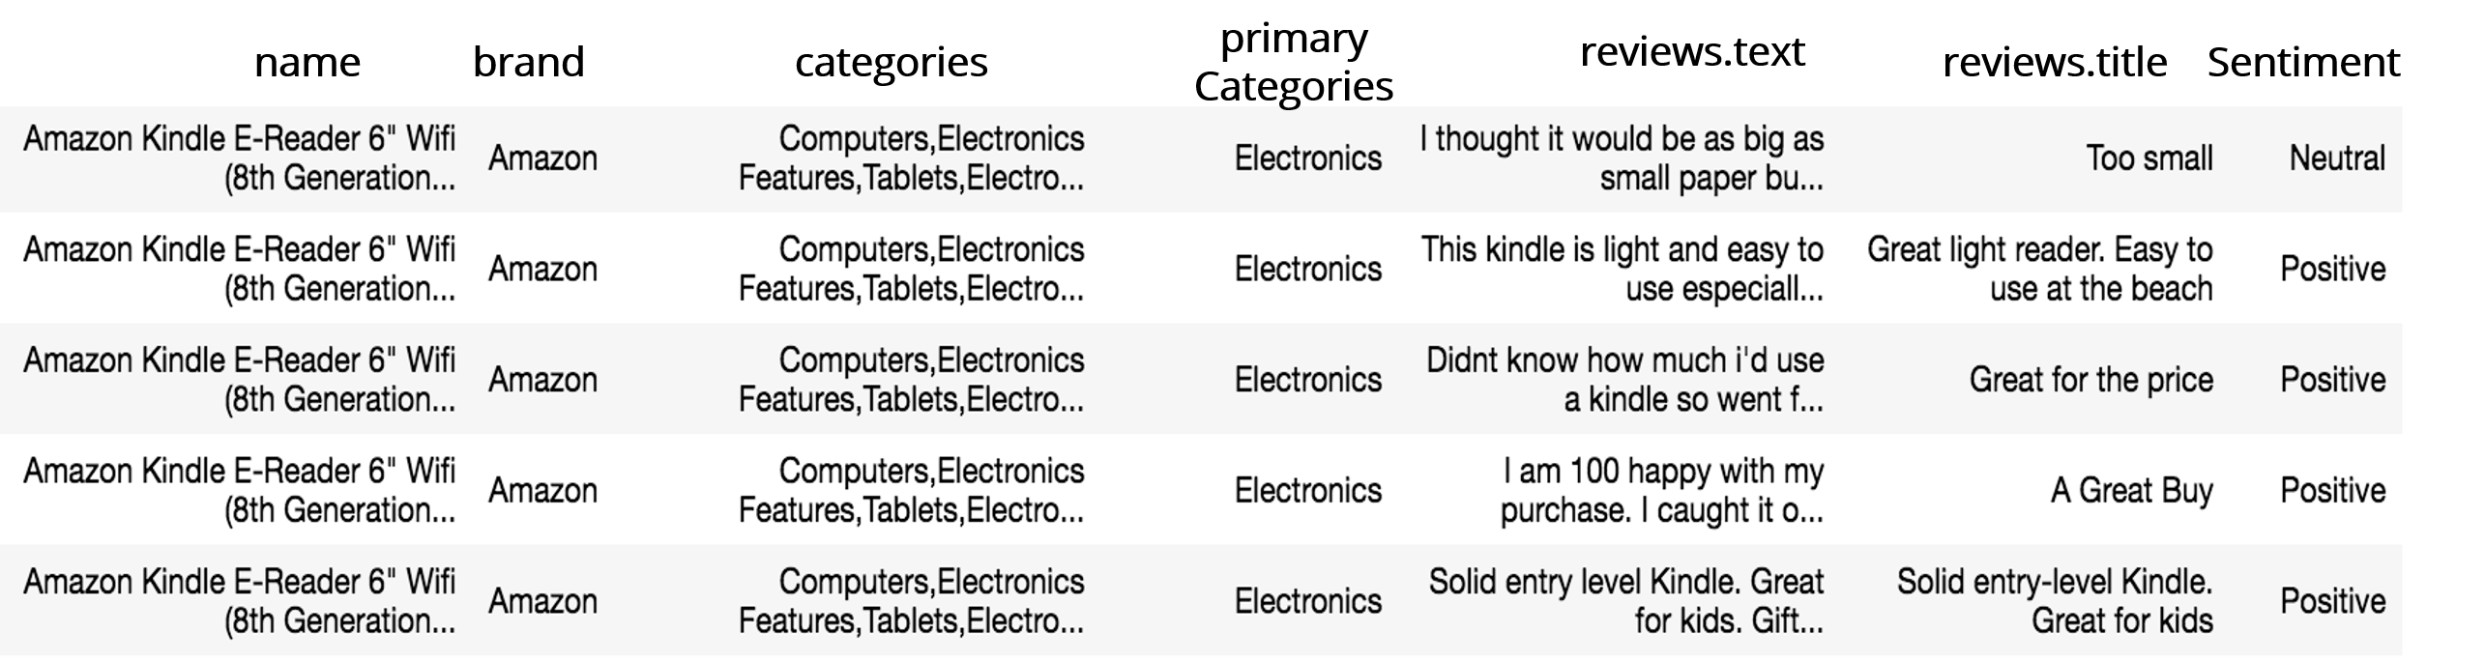
Dataset Snapshot

Slide 12
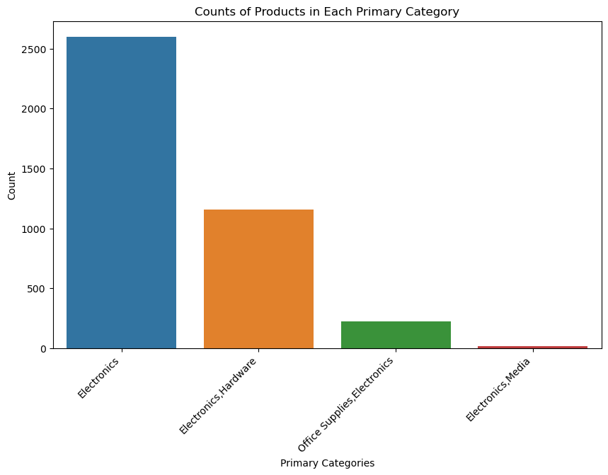
Counts of Products in Each Primary Category

Slide 13
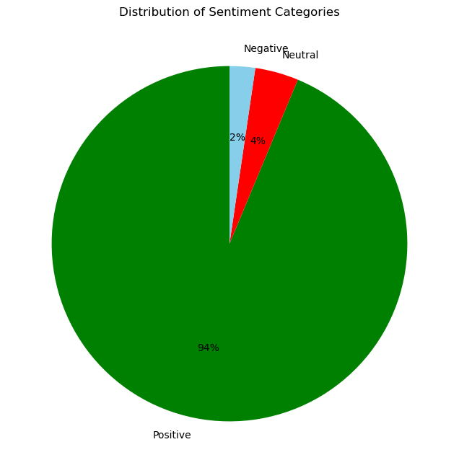
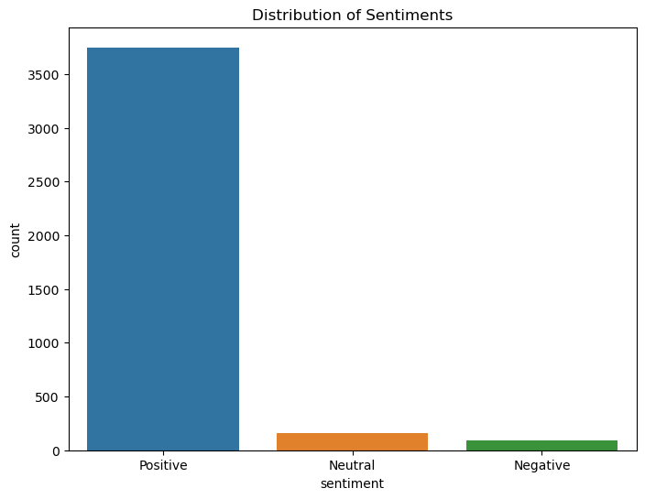
Distribution of Sentiment Categories

Slide 14
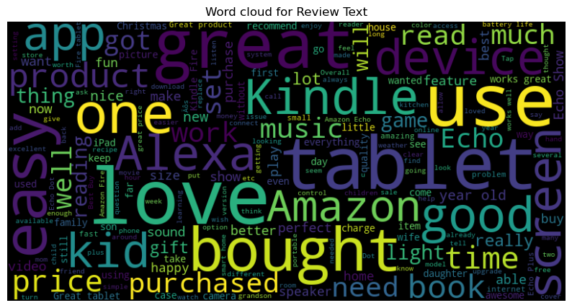
Most Common Texted Words

Slide 15
Data Analysis
Name: |  | Good tablet kid lot app download game
Sentiment: |  | Neutral
Count of Sentiment: |  | 9736
Name: |  | Item work expect great product
Sentiment: |  | positive
Count of Sentiment: |  | 125

Slide 16
CONCLUSION AND FUTURE SCOPE
After analyzing dataset, we can conclude that Machine Learning can be effectively used for understanding the customer’s sentiment.
In conclusion, leveraging machine learning algorithms enables businesses to make informed decisions by analyzing customer sentiment. This approach aids in prioritizing essential organizational actions and areas of focus.
By systematically addressing the class imbalance problem, selecting appropriate classifiers, and exploring advanced modeling techniques, this project aims to develop an accurate and robust sentiment analysis model for e-commerce applications.

Slide 17
Thank You

